Slide 1
The Story of DeFi
+ Major Trends
October 2019 | DeFi.WTF Osaka
Notes:
Honored to be with you here today at Devcon’s headline DeFi event

Slide 2
Agenda
The Story of DeFi
Major DeFi Trends
Notes:
As someone who wants deeply for DeFi to succeed, I’m here to share two things

Slide 3
Why Did We Start DeFi Movement?
Notes:
1.5 years ago DeFi didn’t exist. We worked hard.
We got to know the others in the space

Slide 4
Social Situation
What We Had in Common
Build a system without intermediaries and one that is more fair, transparent, equitable
Realized we were a small piece of something bigger
Reasons for Isolation
No shared forums to discuss challenges and issues
No place to meet and encourage one another
Irony since we valued open source
Notes:
We realized we loved what we did.
We cared deeply about building an open financial system
Contrary to what people may think
Begged the question: why couldn’t we share and work together openly?

Slide 5
An open community of decentralized finance platforms
Goals
Spread awareness of the decentralized finance movement
Help facilitate solving the industry’s most pressing challenges
Values
Open source
Interoperability
Collaboration
Transparency
Notes:
Led to the creation of the DeFi movement

Slide 6
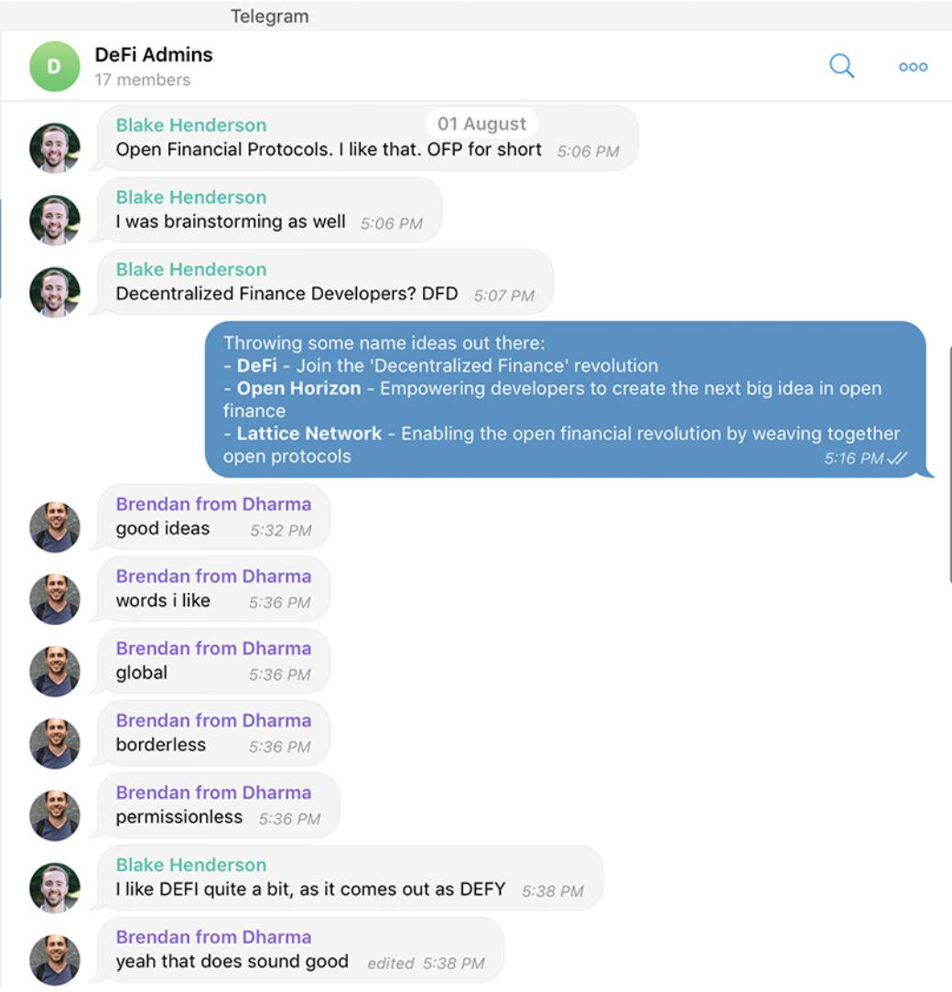
Engagement, mission, and purpose
Creating the identity DeFi
What transpired was the first time that DeFi felt real, that people were engaging, and there was a sense of community around our mission and purpose.
Notes:
- What transpired was the first time that DeFi felt real, that people were engaging, and there was a sense of community around our mission and purpose.

Slide 7
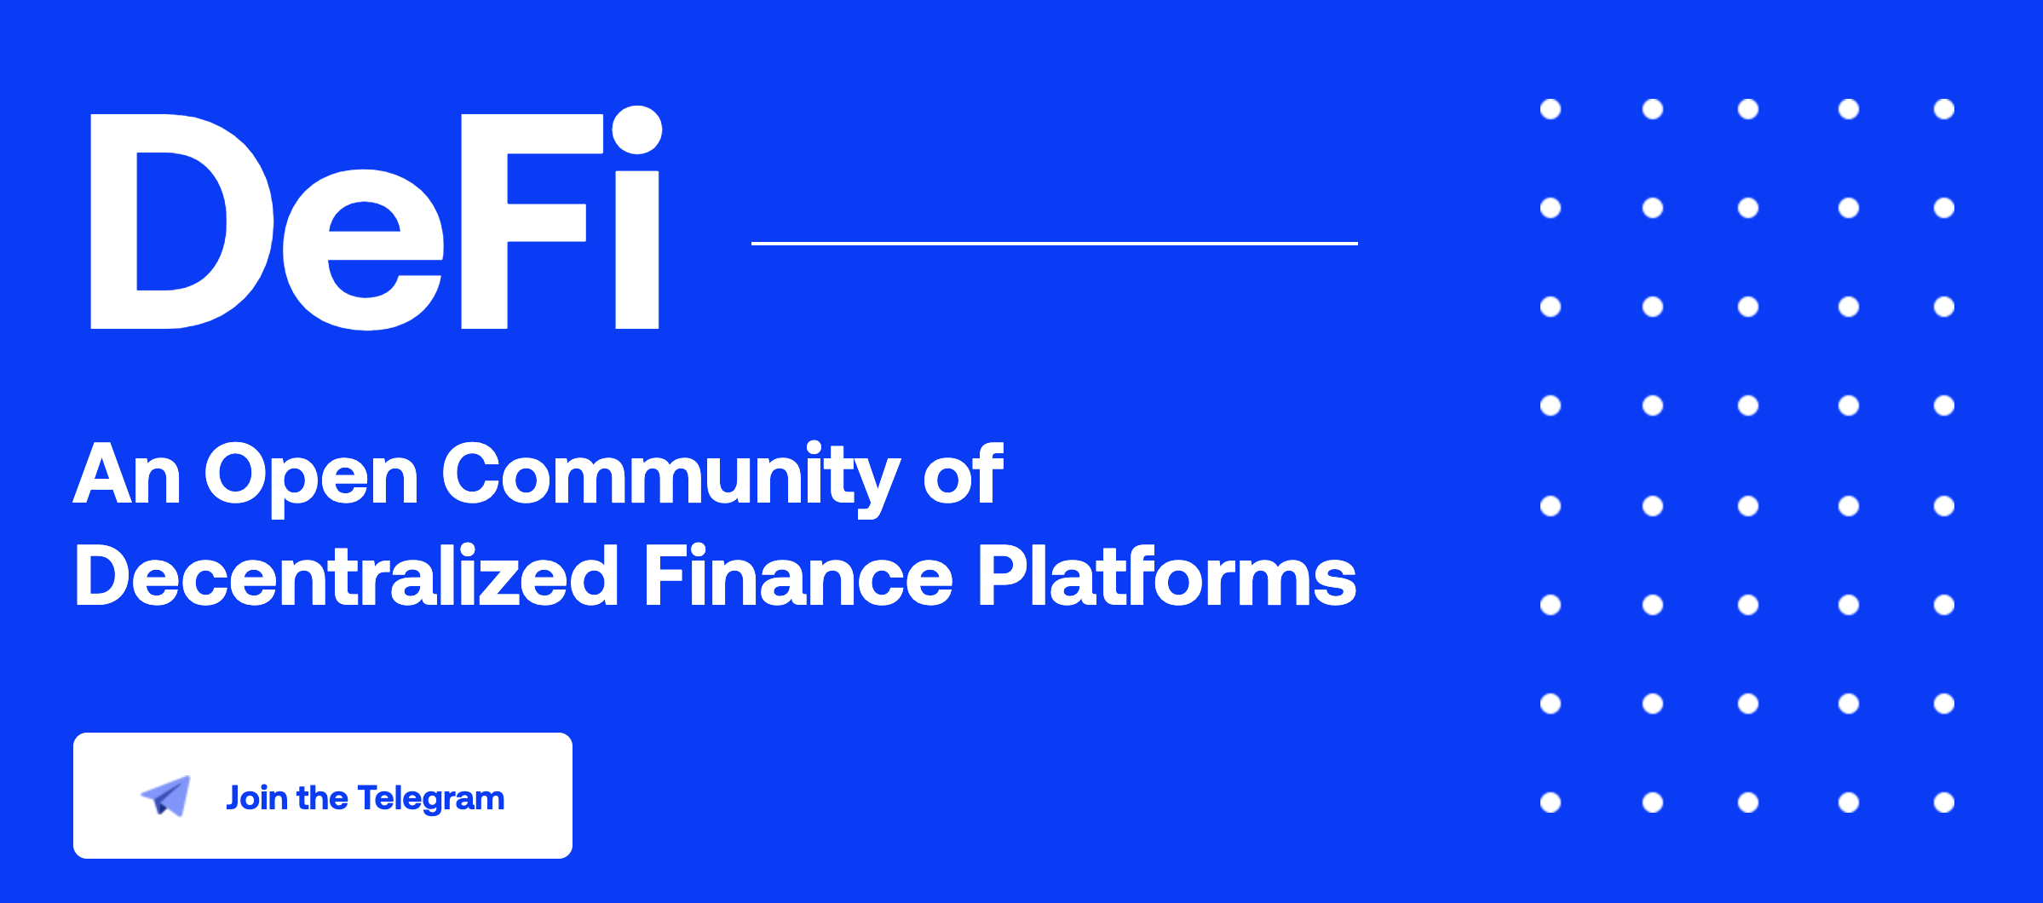
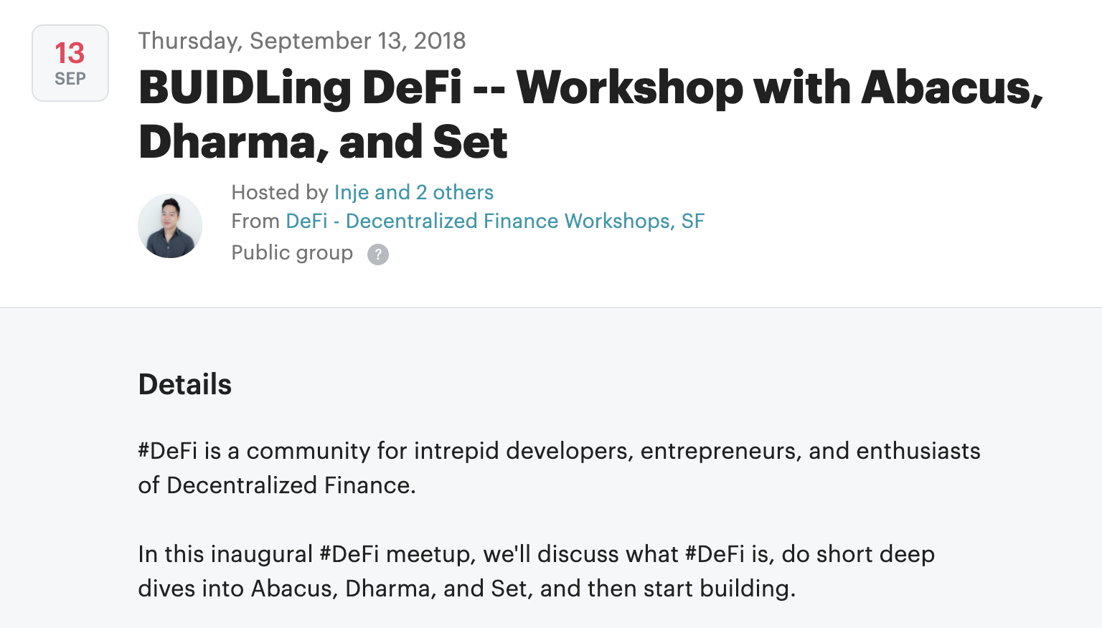


Laying the Foundations
Channels

Slide 8
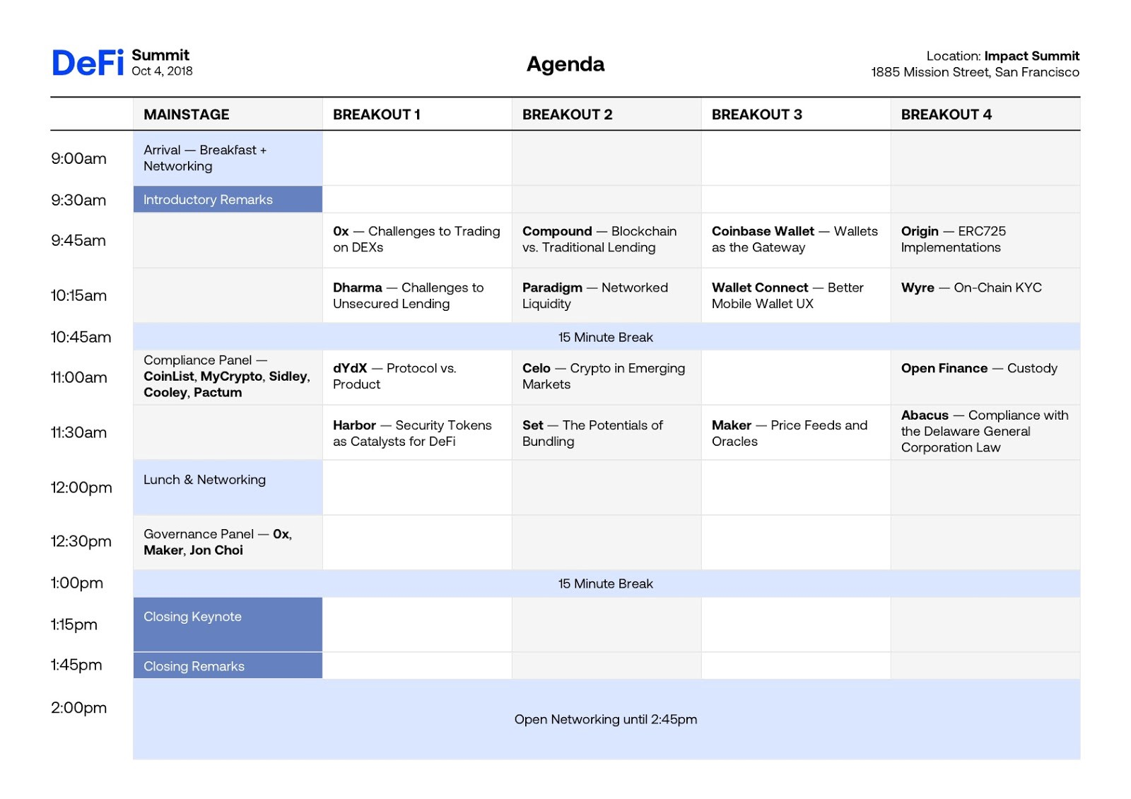
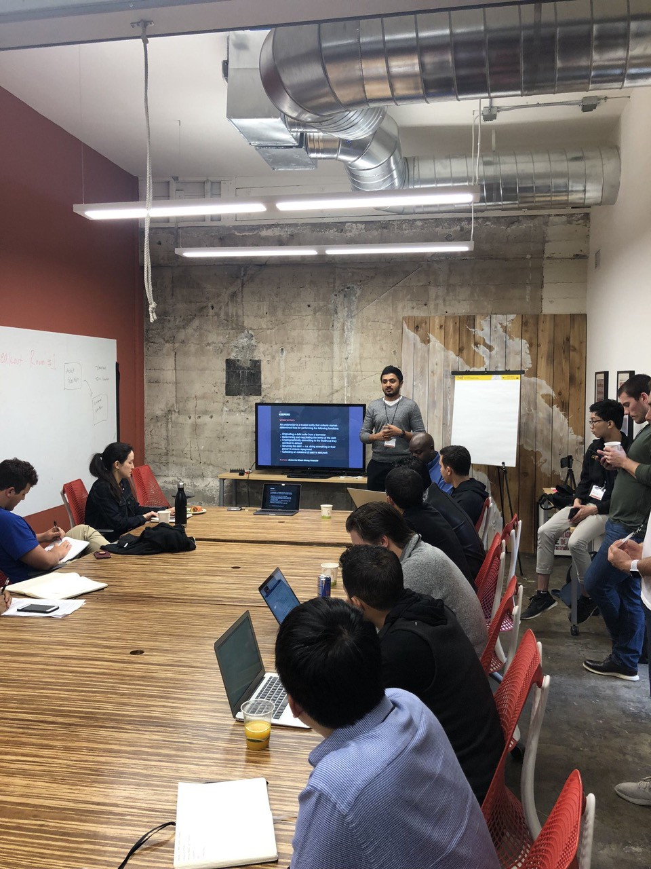
DeFi Summit SF

Slide 9
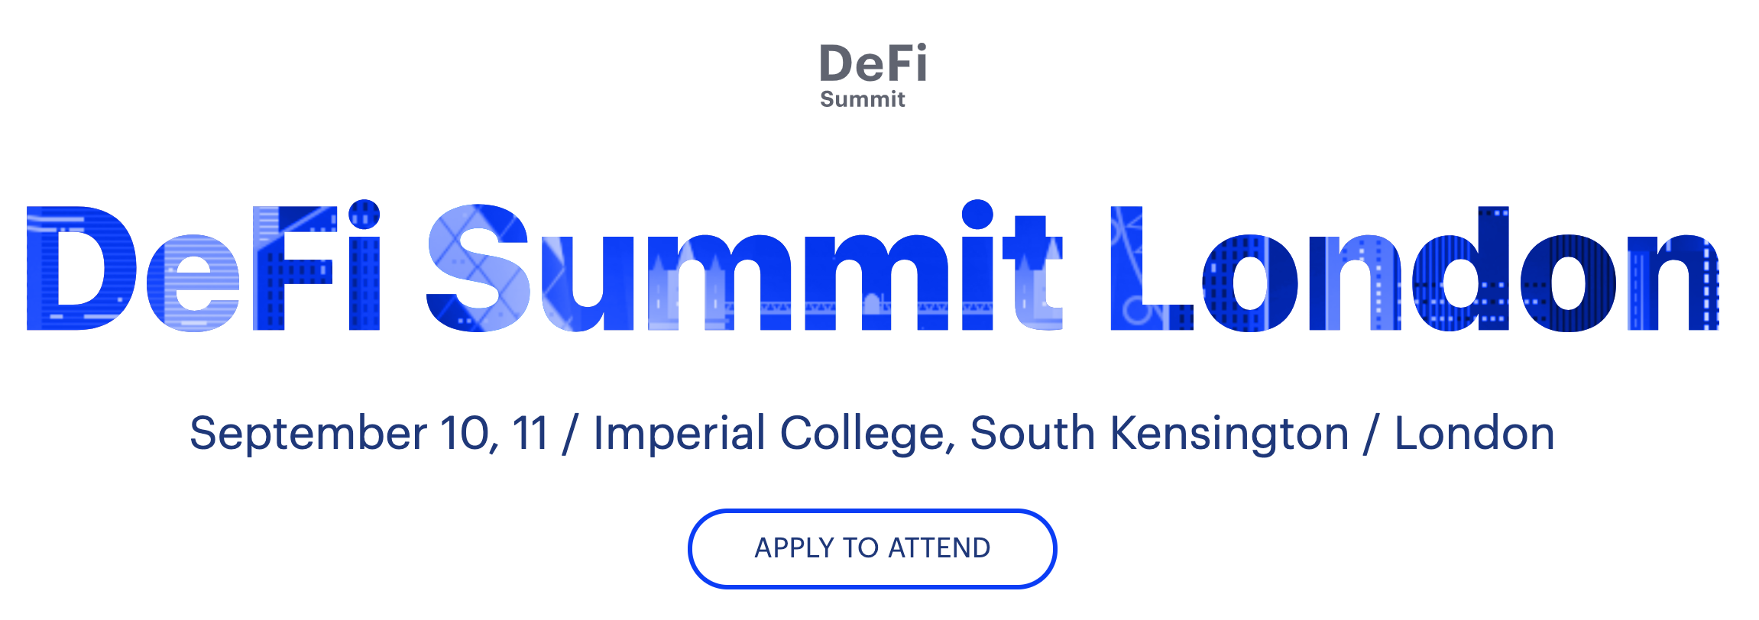
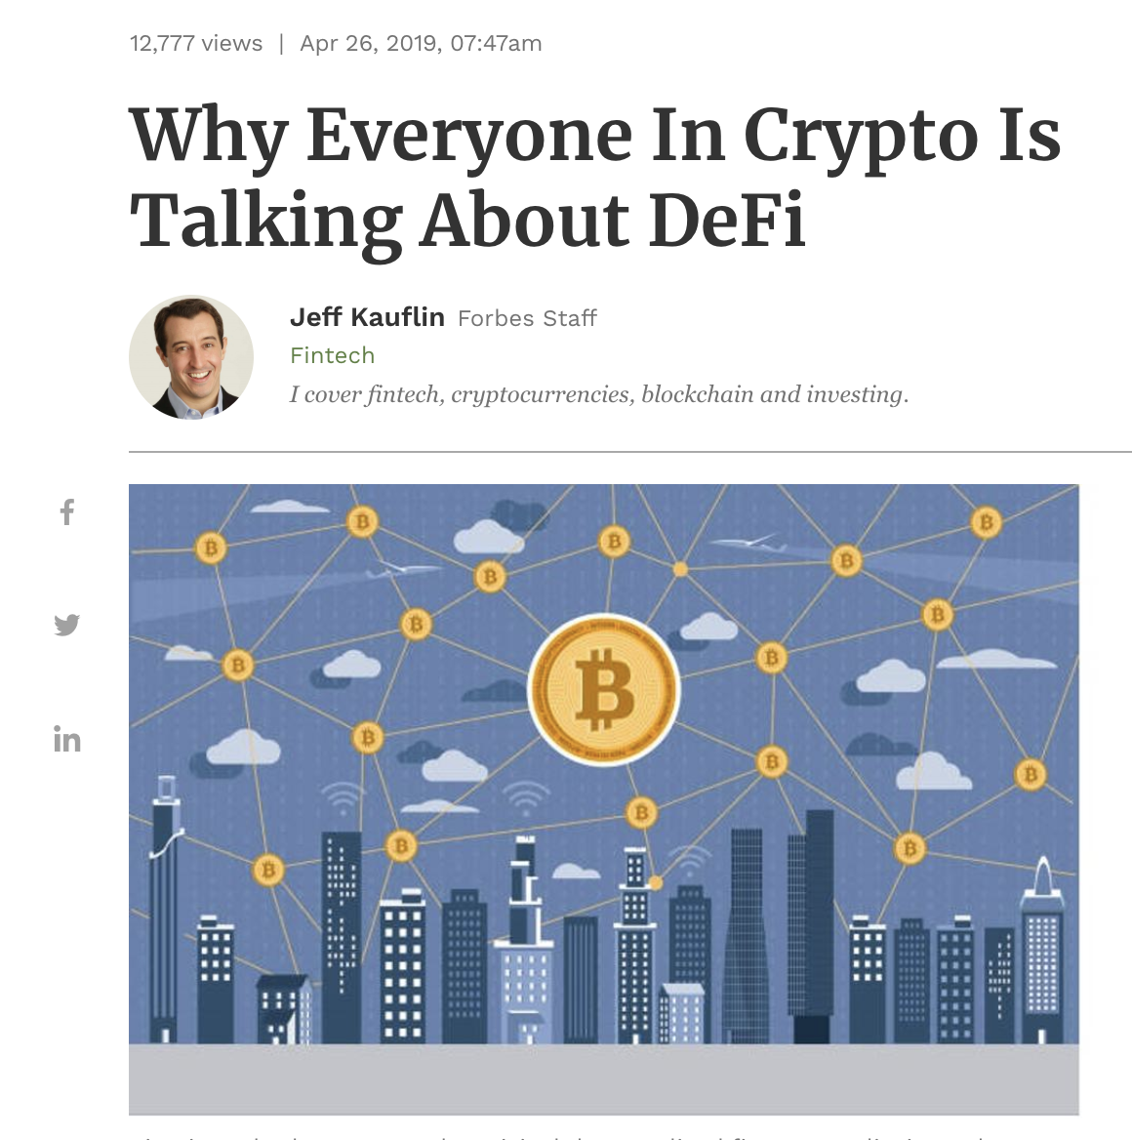
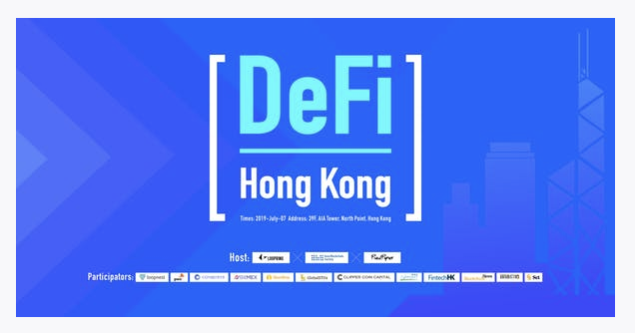
The DeFi Movement with a Life of its own

Slide 10
Takeaway
We’re all in this together
Open Source and Collaborative nature will allow us to make strides towards changing the world

Slide 11
Major DeFi Trends in 2019

Slide 12
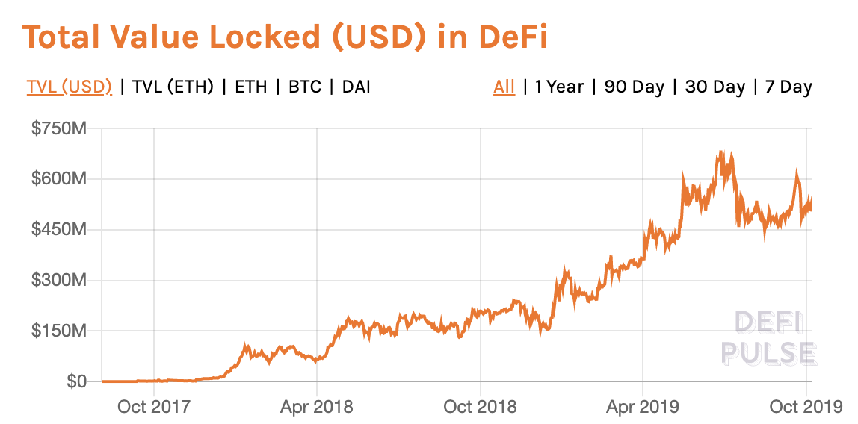
Core Metrics
TVL in DeFi has grown 150% Y-O-Y
Source: defipulse.com
Notes:
High-Value, low frequency transactions

Slide 13
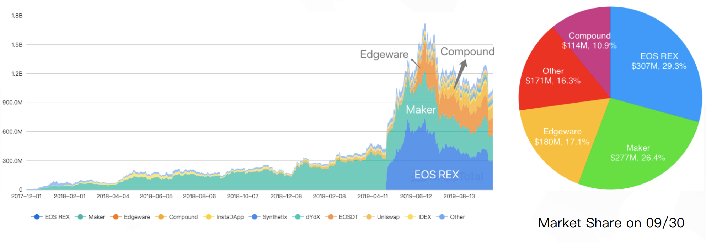
Core Metrics
TVL (including non-traditional DeFi) across dApps has grown
Source: Peckshield: Monthly DeFi Report (09/2019)
Notes:
High-Value, low frequency transactions

Slide 14

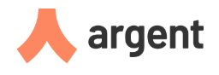


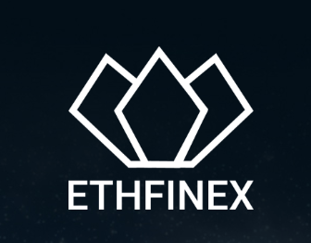


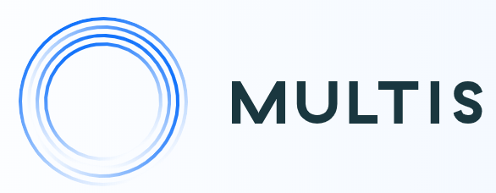



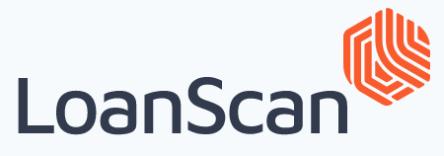
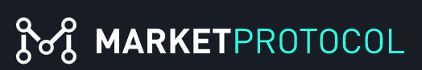




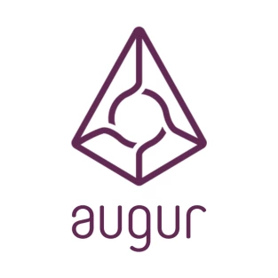
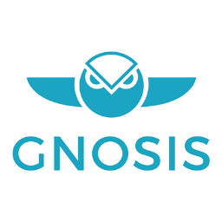


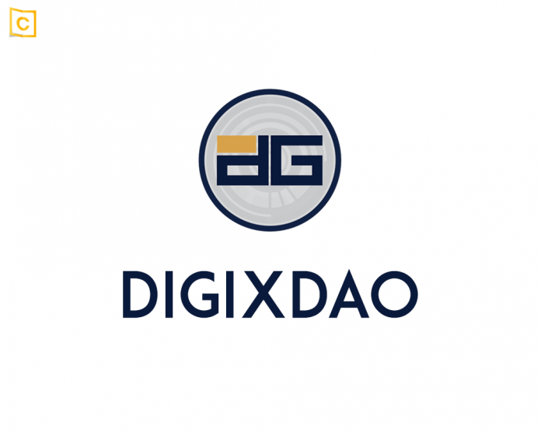

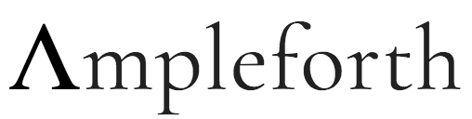

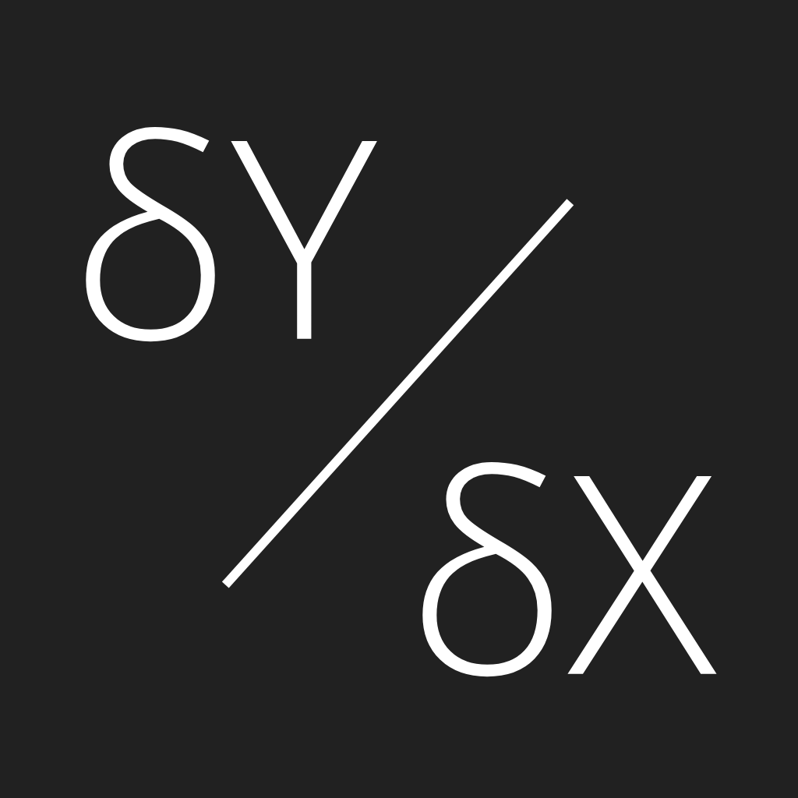


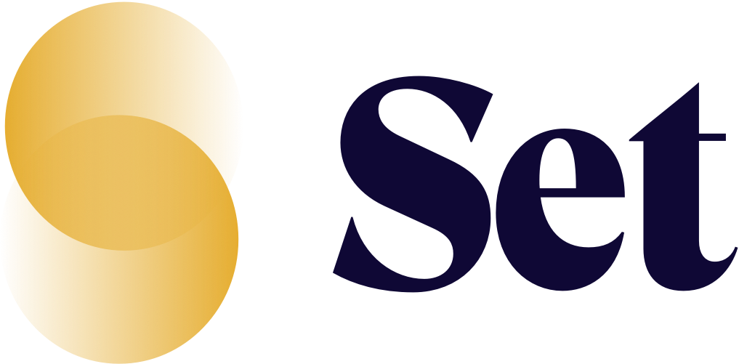

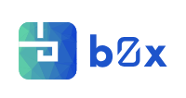
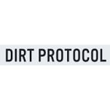

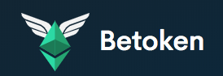


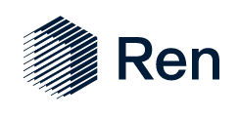
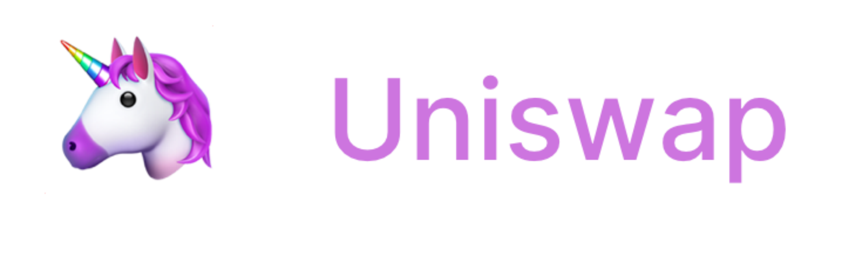


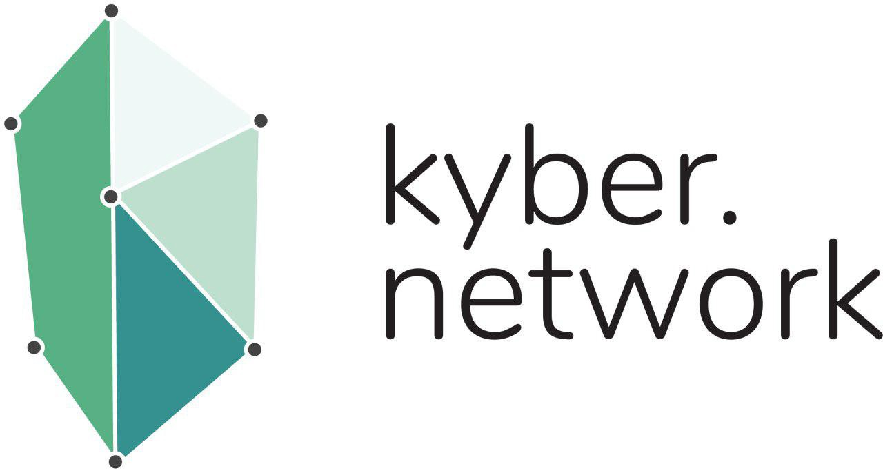
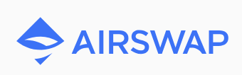
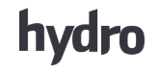
Decentralized Financial Stack
DeFi stack is taking shape...
Decentralized Financial Applications
Synthetic Assets
Real World Assets
Prediction Markets
Securities
StableCoins
Data Infrastructure
Derivatives
Lending
Asset Management
Insurance
Liquidity
Notes:
The DeFi stack is taking shape.

Slide 15
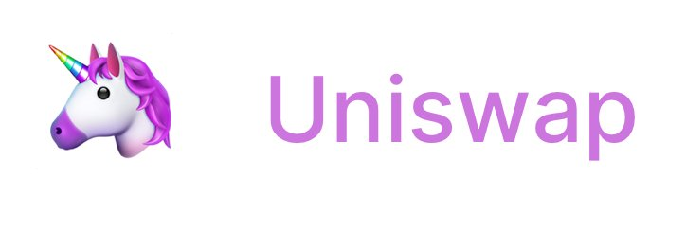
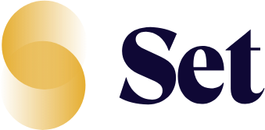

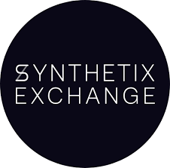

MainNet Launches
Second generation + new primitives go live
Margin
Automated Market Maker
Asset Management
V2
Money Markets
Insurance
Oct 2018
Nov 2018
Apr 2019
May 2019
May 2019
MainNet Launch Dates
2018
Sept 2018
Dec 2018
Jan 2019
May 2019
May 2019
Money Markets V1
Synthetic
Assets
Lending
V2
Exchange
V2
Margin
Notes:
https://medium.com/dragonfly-research/so-you-want-to-build-a-crypto-startup-8904ca300794

Slide 16
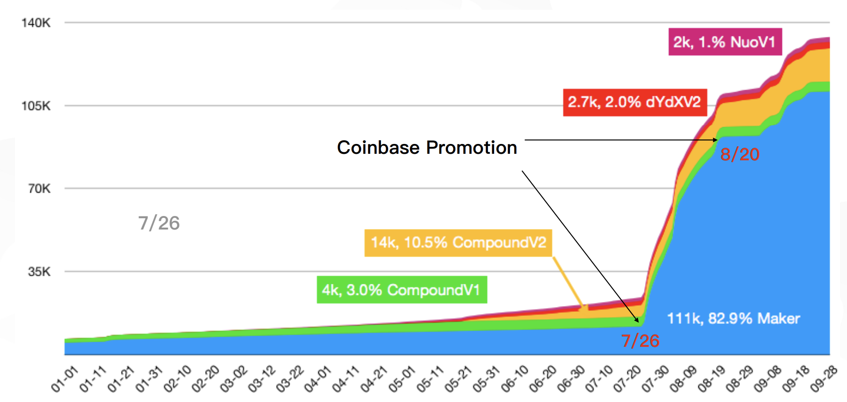
User Growth
# of users growing, with big jump from Maker Coinbase promotion
Source: Peckshield: Monthly DeFi Report (09/2019)
Notes:
https://medium.com/dragonfly-research/so-you-want-to-build-a-crypto-startup-8904ca300794

Slide 17
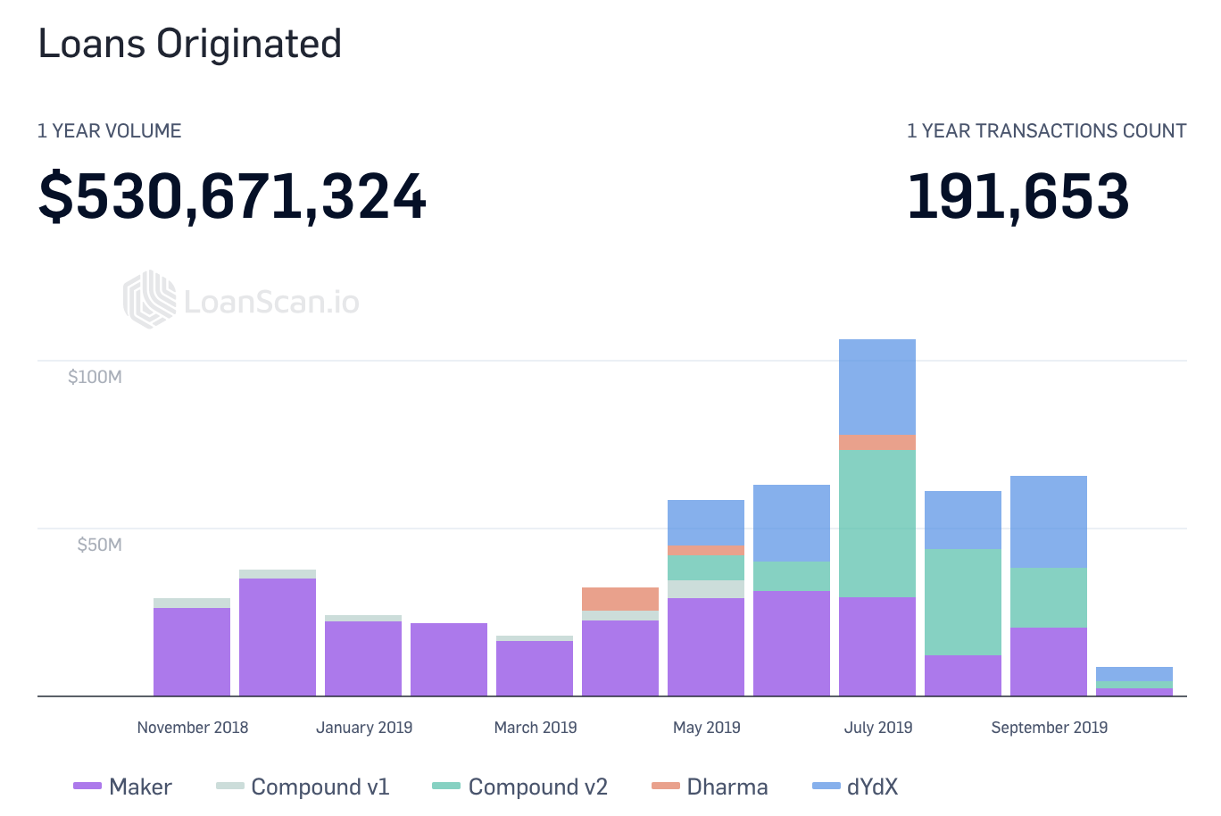
Use Cases
Users Mostly use DeFi to speculate and generate yield
Top Use Cases
Speculation: Margin Trading
Lending: Generating Yield
$150M supplied
$270M ETH locked
~$80M Dai
$105M traded
Source: LoanScan, Compound.Finance, mkr.tools, dydx.exchange
Notes:
https://medium.com/dragonfly-research/so-you-want-to-build-a-crypto-startup-8904ca300794

Slide 18
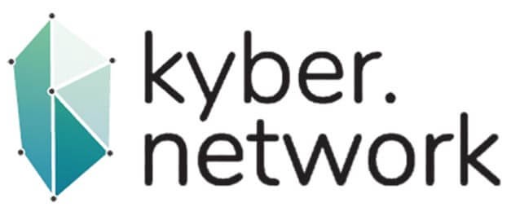
Liquidity Models
P2C has shown greater adoption then P2P...
Peer to Contract
Peer to Peer
Price set by governance or algorithm
Few markets / pairs
No ongoing maintenance
3rd party keepers
Requires discrete counterparty to transact
Requires some notion of “relayer” built on top of protocol to transact
Building more P2C-like features
Pivoted and now building on Compound
Still working on V2
Notes:
Use cases

Slide 19


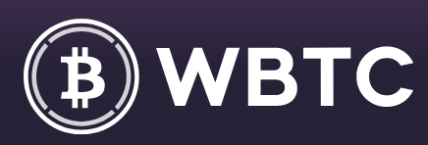
Smart Contract Composability
Contract-level compositions result in new use cases...
cDAI
Interest-generating
lsDAI
Future contracts on cDAI
pooledDAI
Donate using cDAI interest
rDAI
Donate using cDAI interest
xDAI
DAI-based sidechain
swanDAI
Bet on black swan events
Protocol Bridge
DEX
Oracles
Assets

Slide 20
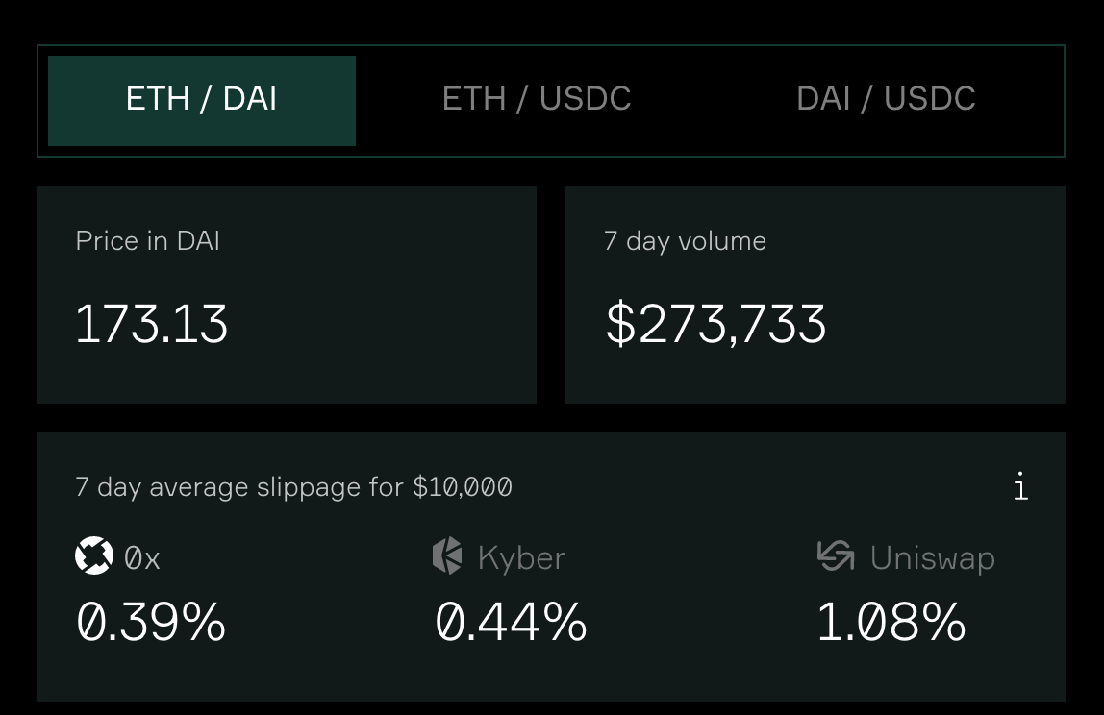
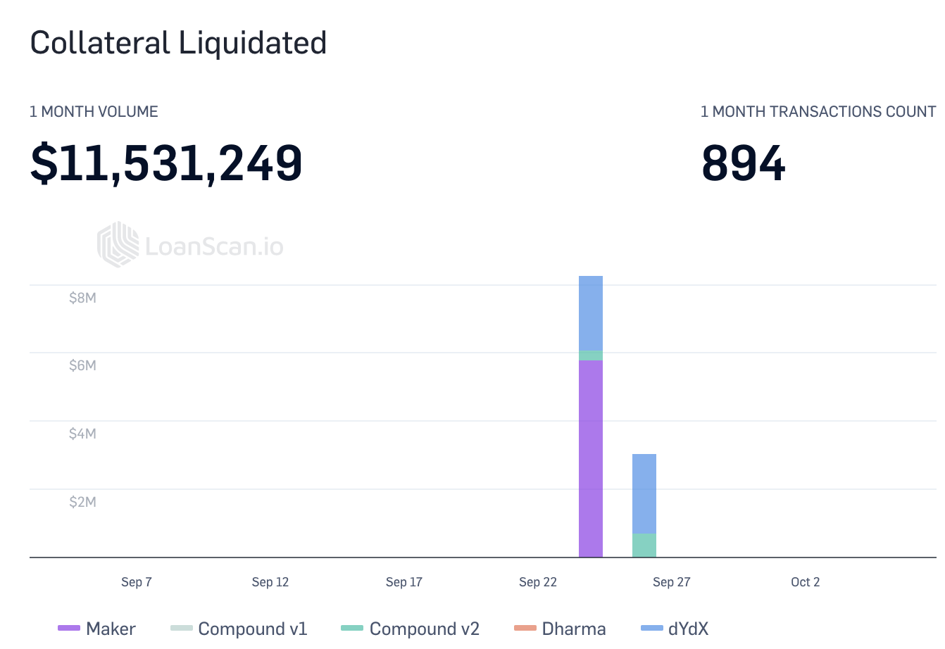
Liquidity
Liquidity a big focus for Dexes and market makers starting to come for flow...
Focus on Liquidity & Slippage
On-Chain Liquidations
On-Chain Rebalances
MACO Set Auction Sizes
$2.1M
$825k
$670k
$360k
Can handle $60-70k per minute
Liquidations mostly from Maker and dYdX
1st MACO Auction
2nd MACO Auction
3rd MACO Auction
4th MACO Auction
Notes:
[Content] 0x on Market Makers
[Content] Kyber working on specific pairs
[Content] Set on liquidity providers
[Content] Maker, Compound, dYdX for Liquidators

Slide 21
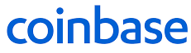
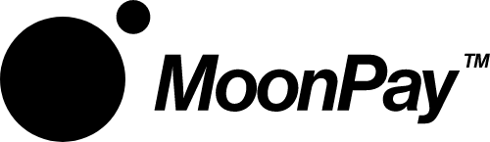




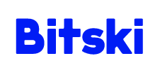
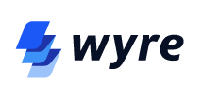

UI/UX
User Friction Being Tackled from Many Sides….
Smart Contract Wallets and Meta-Transactions...
Hosted Wallets...
Onramps...
Abstracts concepts like gas wrapping ETH, and private keys
Help apps offer familiar Web 2.0-like experiences
Onboard users from fiat to crypto
Notes:
[Idea] Bring on Coinbase/Binance users to user their first SC
[Content] Onramp: Wyre, Ramp Network
[Content] Smart Contract Wallets / Metatransactions: Dharma, Argent
[Content] Hosted Wallets: Formatic, Torus, Bitski

Slide 22
Status of DeFi Today

Slide 23
There are numerous challenges...
User Adoption Limited
Mostly crypto-natives using DeFi products
Limited success bringing the crypto-curious to DeFi
Unclear Value Capture
Most non-token protocols currently do not monetize on-chain
Unproven value capture on the user-facing layer
Path to Decentralization Unproven
Few examples of effective on-chain governance
Compounding Smart Contract Risk
WHEN not IF smart contracts break
Security audits remain high-cost; Formal verification out of reach for many
Notes:
Use cases

Slide 24
… which we’re here to solve
User Adoption Limited
How do we bring DeFi to the 100k-1M user mark and beyond?
Unclear Value Capture
How can we build win-win incentives for players on all levels of the stack?
Path to Decentralization Unproven
How can we safely implement governance on-chain?
Compounding Smart Contract Risk
How can we pre-emptively create standards and monitor smart contract risk?
Notes:
Use cases

Slide 25
Building an open financial system together
DeFi.wtf is the perfect venue; Excited about the sessions today
Notes:
I’m excited about
Thank you so much for your time

